Slide 1
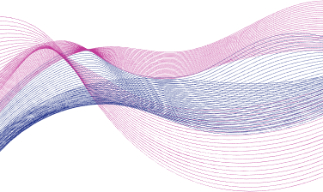

Slide 2
VIDEO QUALITY ASSESSMENT USING TIMESFORMER

Slide 3
PROBLEM STATEMENT
LEVERAGING TRANSFORMER ARCHITECTURES TO MODEL SPATIAL-TEMPORAL DEPENDENCIES IN VIDEOS FOR PREDICTING QUALITY SCORES.

Slide 4
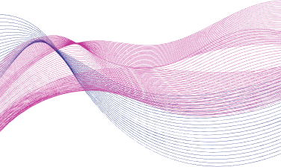
MOTIVATION
With the exponential growth of video-based applications—from streaming platforms and video conferencing to autonomous driving and telemedicine—ensuring high perceptual quality has become a critical challenge.
However, automated Video Quality Assessment (VQA) remains complex due to the interplay of spatial distortions (e.g., blur, noise, compression artifacts) and temporal distortions (e.g., motion flicker, frame drops).
Traditionally, measuring video quality relied on manual inspections or simple algorithms that couldn’t fully capture how humans perceive distortions. While deep learning models like CNNs have improved things, they still struggle with long video sequences because they focus on small patches rather than the big picture.

Slide 5
DATASET DESCRIPTION
The KoNViD-1k (Konstanz Natural Video Database) is a publicly available dataset designed for subjective video quality assessment (VQA). It comprises 1,200 video clips, each approximately 8 seconds in duration, sampled from the YFCC100M dataset.
🔑 KEY FEATURES OF THE DATASET :
📹 Video Specs: 1280×720 resolution, 24/30 fps
🎬 Content Diversity: Various genres & scenes distortions
🧠 Subjective Ratings: Mean Opinion Scores (MOS) via crowdsourcing
📂Data Availability: https://database.mmsp-kn.de/konvid-1k-database.html
Size :
Videos: ~2.3 GB
Metadata: ~3 MB

Slide 6
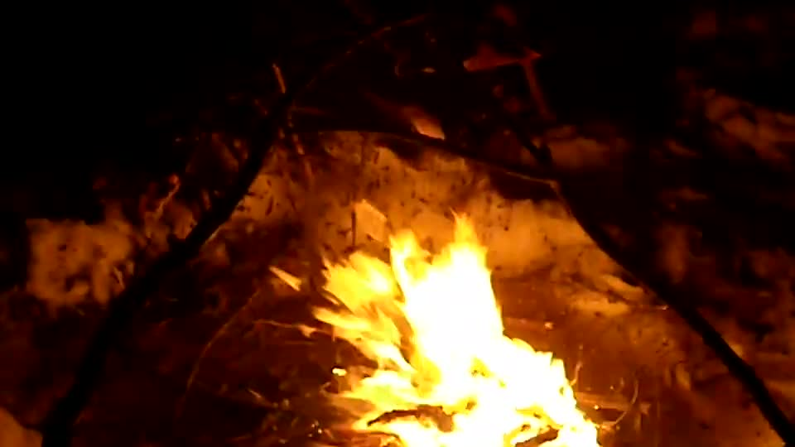
SAMPLE

Slide 7
WHY TIMESFORMER FOR VQA?
Efficient Spatiotemporal Modeling : TimeSformer’s factorized attention mechanism allows it to separately capture spatial and temporal features, which is especially beneficial for VQA where temporal consistency and spatial artifacts both impact perceived quality.
Scalability and Flexibility : The architecture is flexible in terms of input resolution and number of frames, making it suitable for datasets like KoNViD-1k, which contain short-duration, diverse video clips with varying quality levels.
Strong Generalization : Pretrained on Kinetics-400 which is a large-scale video dataset, it demonstrates strong generalization capabilities, making it highly effective for downstream tasks like Video Quality Assessment (VQA) with minimal fine-tuning.

Slide 8
TIMESFORMER ARCHITECTURE
TimeSformer is built exclusively on the self-attention mechanism used in Transformer models, which makes it possible to capture space-time dependencies over the entire video.
In order to apply Transformers to video, our model interprets the input video as a time-space sequence of image patches extracted from the individual frames.
Precisely as NLP Transformers infer the meaning of each word by comparing it with all the other words in the sentence --a procedure known as self-attention, our model captures the semantics of each patch by explicitly comparing it with the other patches in the video.
This makes it possible to capture short-term dependencies between neighbouring patches as well as long-range correlations between distant patches .

Slide 9
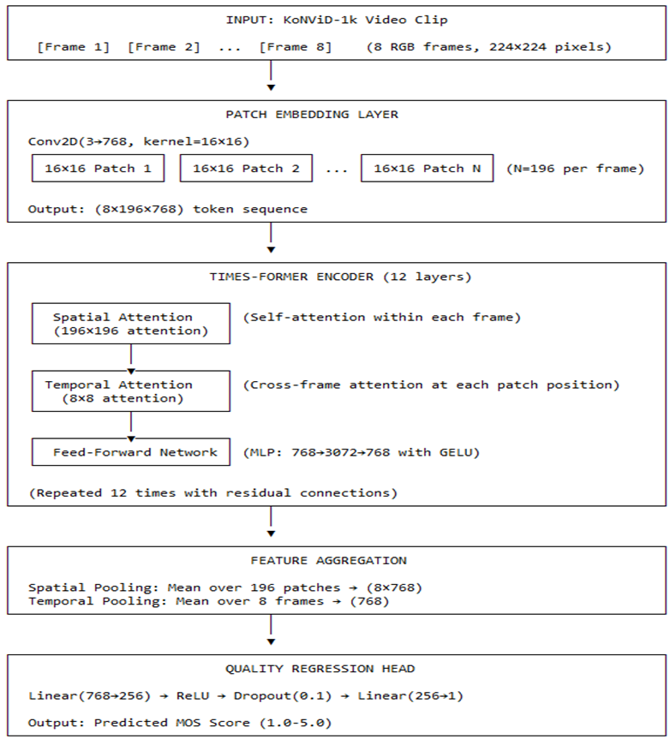
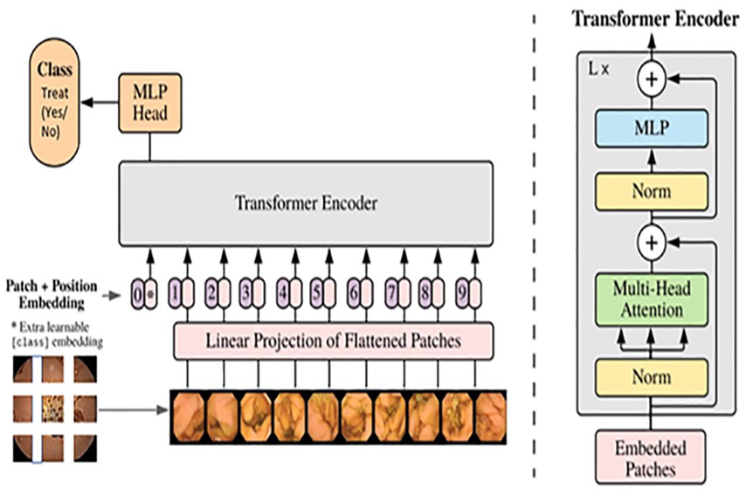
ARCHITECTURE

Slide 10
TIMESFORMER ARCHITECTURE
BREAKDOWN OF THE ARCHITECTURE
Input Processing (Embedding Layer) :
Patch Embeddings :
Uses a Conv2d(3, 768, kernel_size=(16,16)) to split each video frame into 16×16 non-overlapping patches.
Projects each patch into a 768-dimensional embedding space .
Positional Embeddings :
Adds learnable spatial position embeddings .
Includes temporal position embeddings for video sequence modelling .

Slide 11
TIMESFORMER ARCHITECTURE
TimeSformer Encoder (Core Architecture) :
Consists of 12 identical transformer layers, each containing:
Dual-Attention Mechanism :
Spatial Attention (within frames)
Standard multi-head self-attention (MHSA) operating on patches within each frame .
Captures relationships between different spatial regions .
Temporal Attention (across frames):
Separate MHSA operating along the time dimension for each spatial position .
Uses identical structure as spatial attention but processes temporal sequences .

Slide 12
TIMESFORMER ARCHITECTURE
Feature Processing :
Layer Normalization
Feed-Forward Network
Residual Networks
Output Processing :
Final LayerNorm over the 768-dimensional embeddings
Original classifier head is replaced with Quality Prediction Head
Quality Prediction Head :
Custom regression head for quality scoring .

Slide 13
MODEL TRAINING
Data Preparation :
The dataset is split into Training and Test sets using an 80/20 ratio, where 80% of the data is used for training and 20% is for testing.
Number of Samples:
Total Videos: 1200.
Training Set: 960.
Test Set: 240.
Preprocessing steps :
Resizing input size : 224x224
Number of frames : 8

Slide 14
MODEL TRAINING
Hyperparameters
Learning rate : 1e-4
Optimizer : AdamW
Batch size : 1
Number of epochs : 15
Loss function : Mean Squared Error (MSE)
Training Setup
Google Colab T4 GPU

Slide 15
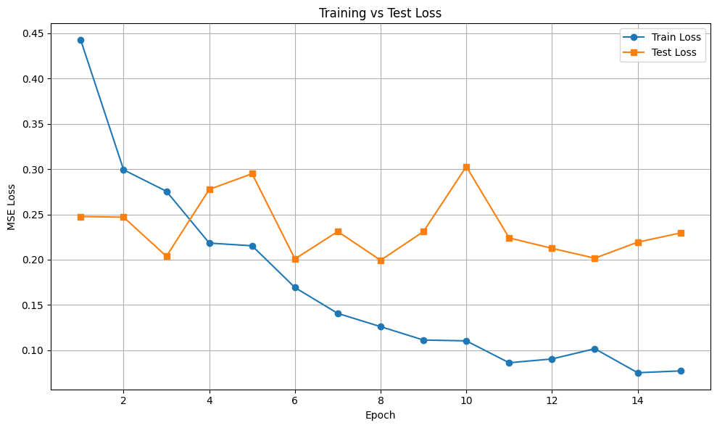
Batch size
TRAINING PERFORMANCE
Train Loss: 0.0771
Test Loss: 0.2295

Slide 16
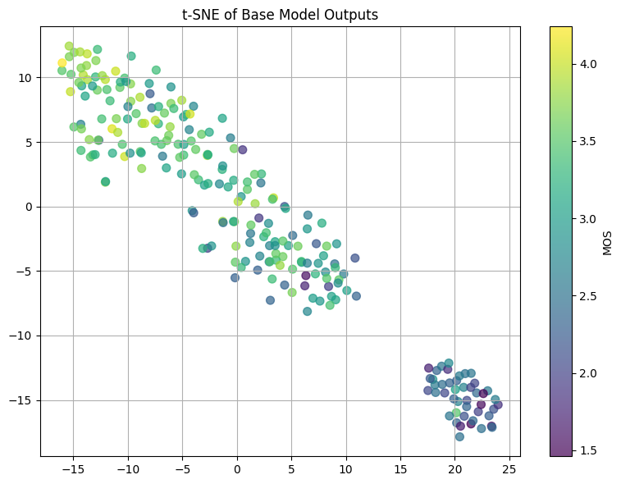
Batch size
T-SNE (T-DISTRIBUTED STOCHASTIC NEIGHBOR EMBEDDING)
The t-SNE plot visualizes the base model's outputs(test data), revealing two main clusters based on sample similarity. Color-coded by MOS, the plot shows that high-quality (higher MOS) and low-quality (lower MOS) samples are relatively well-separated, indicating the model’s partial ability to differentiate between good and poor outputs.

Slide 17
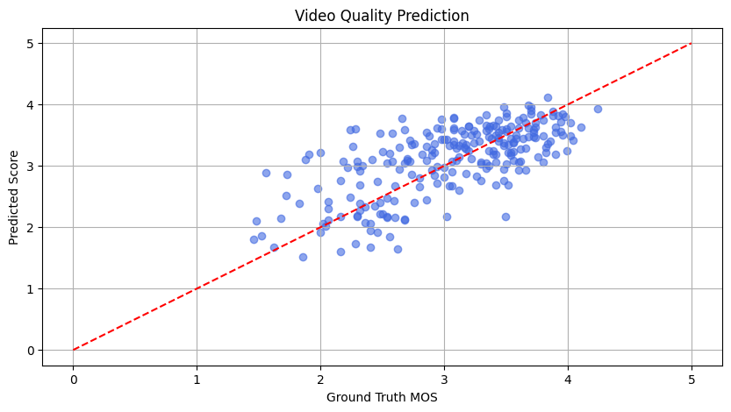
Batch size
SCATTER PLOT
This scatter plot compares the predicted video quality scores with the ground truth MOS. The predictions generally follow the ideal diagonal line, indicating a good correlation between predicted and true scores. Some variance is observed, particularly at the lower and higher MOS ranges, suggesting areas for further model improvement.

Slide 18
EVALUATION METRICS
PLCC (Pearson Linear Correlation Coefficient) : 0.6831
Measures linear correlation between predicted and actual scores.
SRCC (Spearman Rank Correlation Coefficient) : 0.6502
Measures rank correlation (how well the predictions preserve the order of true scores)
RMSE (Root Mean Squared Error) : 0.4790
Measures average difference between predicted and real scores — lower is better

Slide 19
CONCLUSION
Developed a Transformer-Based Video Quality Assessment system leveraging the TimeSformer architecture.
Utilized the KoNViD-1k dataset to train and evaluate the model, focusing on predicting perceptual video quality.

Slide 20
REFERENCES
https://ai.meta.com/blog/timesformer-a-new-architecture-for-video-understanding/
https://huggingface.co/docs/transformers/main/model_doc/timesformer
https://arxiv.org/pdf/2102.05095
https://www.testdevlab.com/blog/vqtdl-no-reference-algorithm-for-video-quality-assessment-developed-by-testdevlab
https://www.researchgate.net/publication/390317271_AIDriven_Video_Quality_Assessment_and_Enhancement_Techniques

Slide 21

Batch size
ANY QUESTIONS?

Slide 22
THANK YOU

